Slide 1
Chris Goode
Solo Performance Practitioner

Slide 2
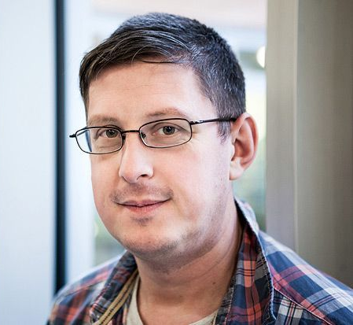
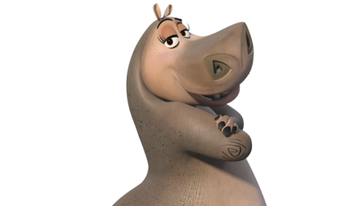
Biography
Chris Goode is a writer and maker working in theatre and live performance. He has amassed a body of work in diverse formats: from large-scale theatre-based projects to intimate solo storytelling pieces, and from script-based pieces to more experimental works
Notes:
Chris Goode is a writer, maker, director, performer working in theatre and live performance. He has amassed a significant body of unpredictable work in diverse formats: from large-scale theatre-based projects such as The Consolations (1999) and Speed Death of the Radiant Child (2007), to intimate solo storytelling pieces like Hippo World Guest Book and Keep Breathing which I will be looking at in this presentation. His solo work also includes Kiss of Life (2002) and We Must Perform A Quirkafleeg! (2006), one of a series of performances made specifically for audiences’ own homes. He has also created script-based pieces like King Pelican (2009, nominated for a TMA Award for Best New Play) to more experimental works such as Hey Mathew (2008), and Glass House (2009), a performance installation at the Royal Opera House.

Slide 3
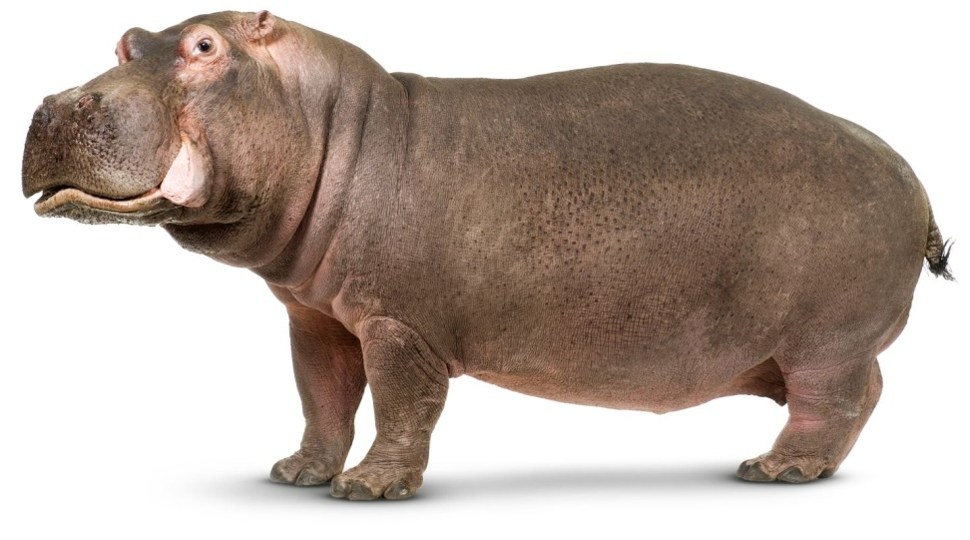
Hippo World Guest Book
About an unmoderated guest book on a now dead website called ‘Hippo World’
Introduces the show as himself
Scripted by others
Uses duration to turn comedy into something more thought provoking
Reads all comments verbatim
“It was more important to them to press send, than to not press send. If you bare that in mind, that’s what makes this show art rather than randomness.”
Notes:
The website was built in 2000 by Ramon Valencia for hippo fans to share pictures and discuss their favourite animal. The website shut down in 2006
Structure
Improvised pre-amble
Recorded introduction
Show
Show lasts for 1 hour
Narrative progression – Starts off with very enthusiastic hippo fans. Steady increase in ‘trolls’ until arguments begin. Increase in spam causing website death
Made sure to include the first comment and last comment but edited out a lot in the middle to reduce time from 12 hours
Verbatim – Shouts out all words in capital letters and reads spelling errors as they are. Included one post of keyboard mashing and spam at the end.
00:45, 8:30, 21:20, 31:30 1:03:20 1:09:30

Slide 4
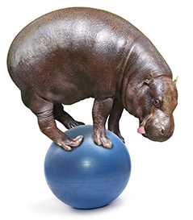
The Internet
The wide reach of the internet brings together people with niche interests
Online anonymity encourages extreme behaviour
The power of free speech without moderation can be chaotic
Businesses will use bots take advantage of potential advertising in any space
Notes:
The piece addresses many topics of discussion which are encompassed by the setting of the online world.
Surprisingly thought provoking.

Slide 5
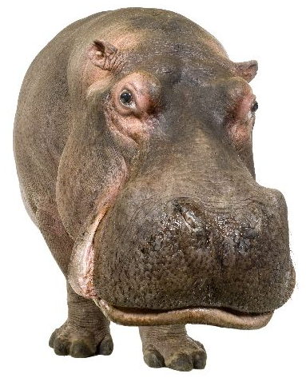
Keep Breathing
E-mailed 6 people asking what they would say to the world if they had one breath to say it in
Introduced the show as himself and created an intimate atmosphere
Encouraged audience participation without making people uncomfortable
Told true stories around people’s messages
Sharing messages that aren’t his own
“I’ll tell them whatever you want as long as you can say it in the space of one breath”
Notes:
Encouraged people to pass the e-mail on to others like a chain mail to reach unknown strangers. Similar to Dave Gorman’s Google Whacking
Drum Theatre in Plymouth set with tables and chairs and beanbags.
Found the member of the audience who was furthest from home.
He met up with some people who had interesting things to say or researched the things that some people talked about.
His first three messages were a polite refusal, and someone who wanted a fight
14:00, 22:40, 1:17:30,

Slide 6
One Breath
Demonstrates how quickly one persons actions can spread to far places
Provokes thoughts about the power of a single breath when we all have a limited number of them
Everybody is closely connected in someway
What matters to any person in a moment can have much variation

Slide 7
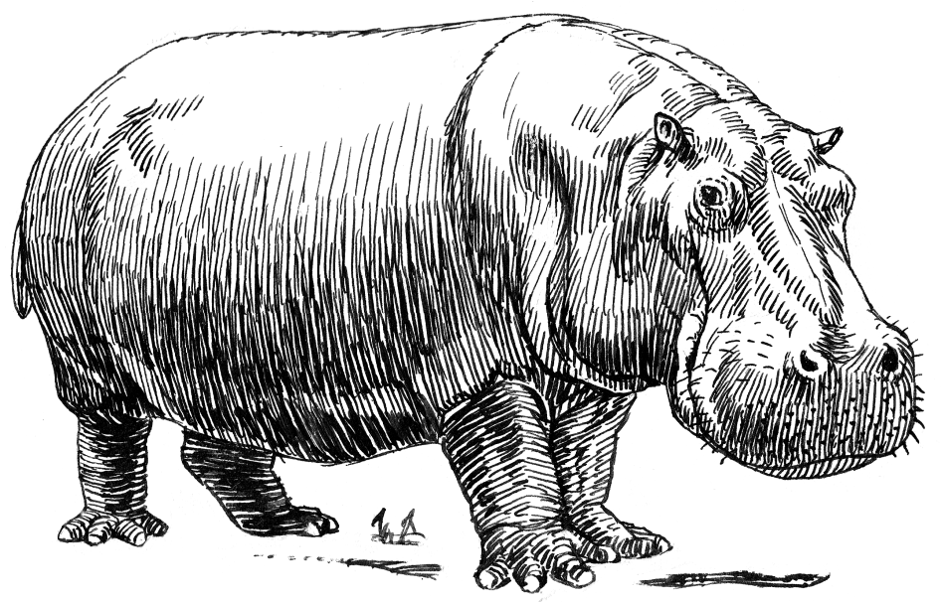
Other Shows
Monkey Bars
Language Thinks Language
The Adventures Of Wound Man And Shirley
Recovery
At Home
Hey Mathew
Longwave
We Must Perform A Quirkafleeg!
Yeah Boom: A Christopher Knowles Reader

